Slide 1
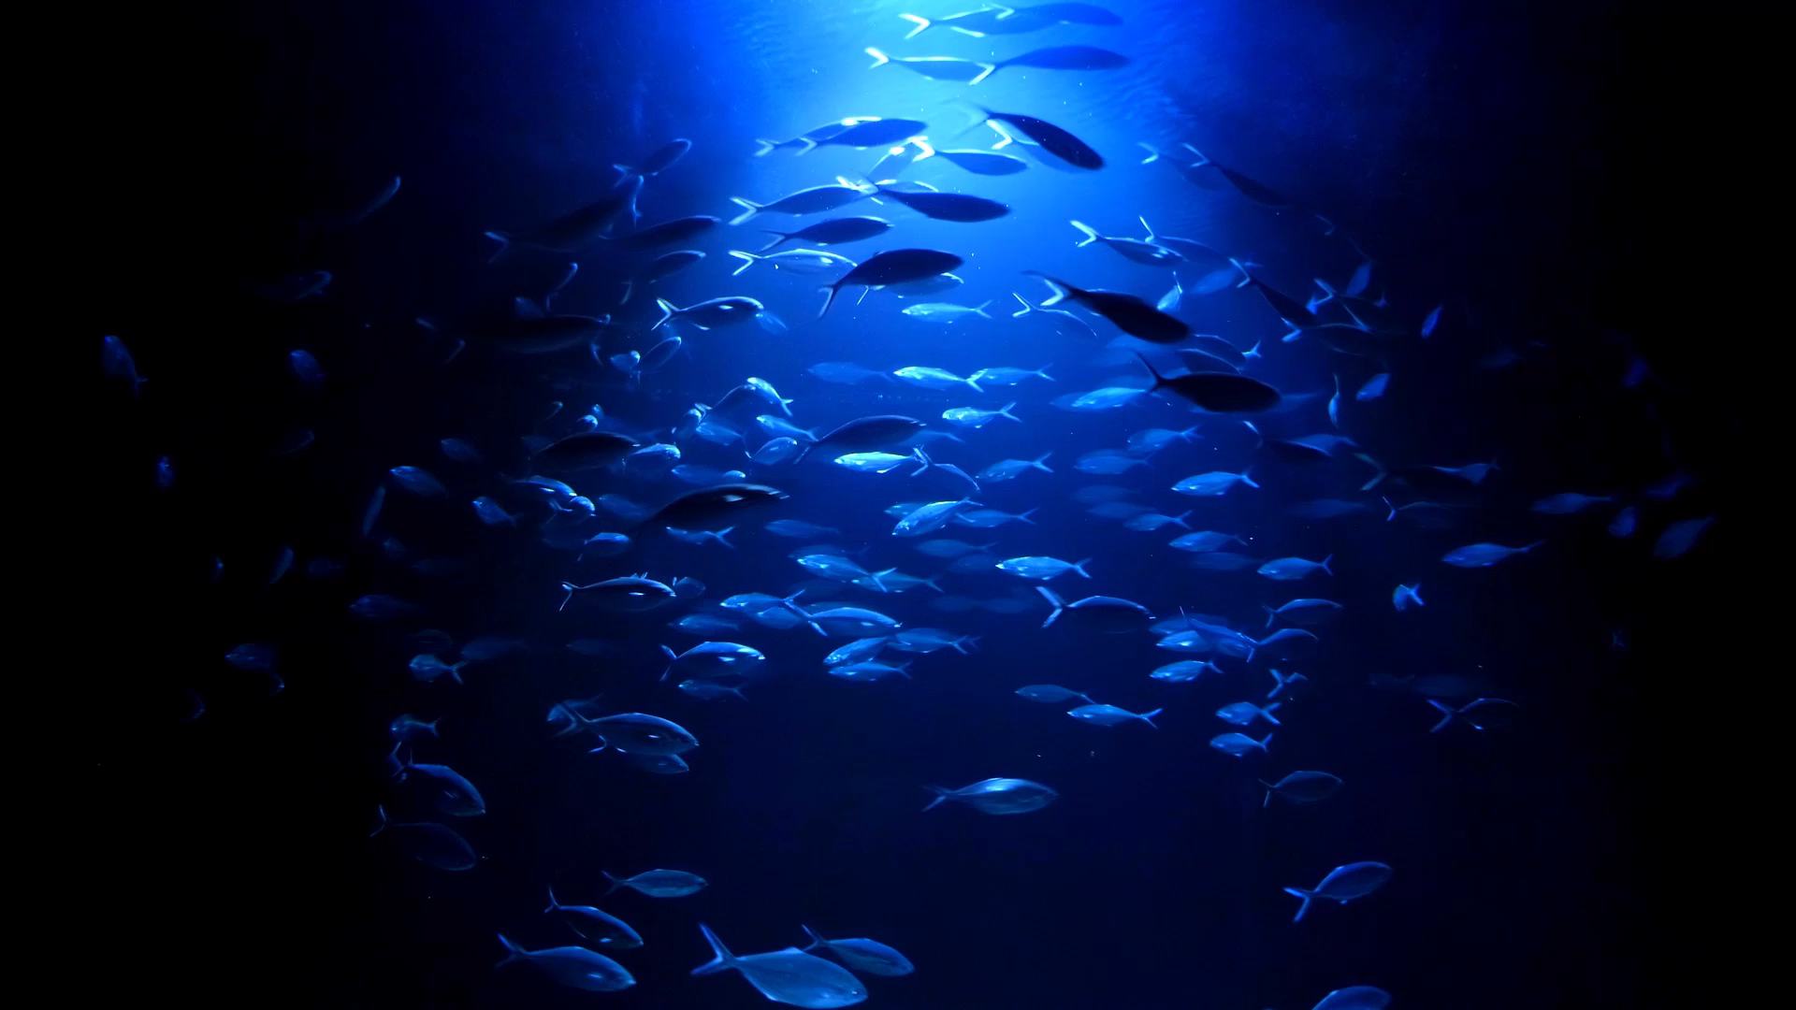
The Coral Rescue

Slide 2
Content
Introduction
Problem Statement
Solutions
Impact of vision2030
Quote
Data
Model
Limitations
Demo
Future work
Conclusion

Slide 3
Introduction
Coral reefs are essential marine ecosystems.
Coral reefs face threats from climate change, pollution, and other human activities
Monitoring coral health is critical for conservation efforts.

Slide 4
Impact of vision2030
NEOM and KAUST are participating in the largest coral restoration project in the world, called the "KAUST Coral Reef Restoration Initiative," as part of the 2030 vision.

Slide 5
"نحن في سباق مع الزمن لإنقاذ الشعاب المرجانية، وتعاني الشعاب المرجانية في جميع أنحاء العالم من أزمة".
“We are in a race against time to save coral reefs, and coral reefs around the world are in crisis”.
KAUST President Tony Chan

Slide 6
Problem Statement
Coral reefs are under significant threat from bleaching, which puts marine biodiversity at risk.

Slide 7
Solution
Develop a deep-learning model to classify coral as either bleached or healthy.
Applying computer vision technology to detect and monitor fish populations.

Slide 8
Data
Coral Dataset:
Total Images: 923
Categories: Bleached and Healthy
Training Set: 80% (738 images)
Test Set: 10% (92 images)
Validation: 10% (93 images)
Fish Dataset:
Total Images: 98
Categories: Low F and High F
Training Set: 80% (79 images)
Test Set: 20% (20 images)

Slide 9
Model
Coral Classification:
Convolutional Neural Network (CNN)
VGG16
ResNet50
ResNet50 | VGG16 | CNN
10 | 10 | 5 | Epochs
0.72 | 0.46 | 0.52 | Loss
0.55 | 0.76 | 0.73 | Accuracy

Slide 10
Model
Fish Detection:
YOLOv5
YOLOv5
50 | Epochs
0.977 | Precision
0.923 | Recall
0.959 | mAP50

Slide 11
Limitations
Encountered difficulties in data collection for training the models.
Due to the data limitations, we could not implement the confusion matrix in fish detection.

Slide 12
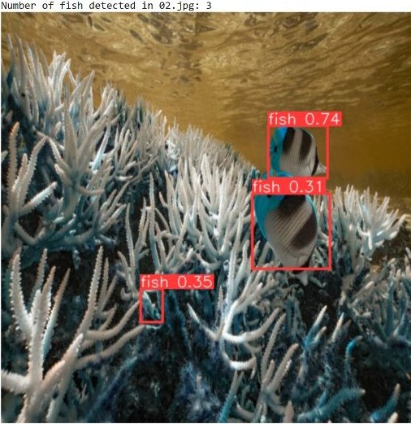
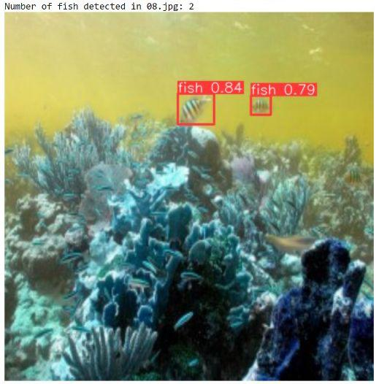
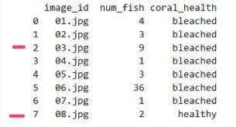
Output

Slide 13
Future work
To enhance the Coral Rescue project's effectiveness, we plan to develop an application that utilizes augmented reality and artificial intelligence. This application will assist divers in identifying and classifying various types of coral underwater, incorporating features such as camera functionality for real-time coral classification.

Slide 14
Conclusion
In conclusion, this project developed computer vision with deep learning and used YOLO, CNN, VGG, and ResNet to assess coral health by analysing images and counting fish accurately. This tool is vital for monitoring and protecting coral reefs from bleaching, a major threat to marine biodiversity. Improved data and model development will expand its applicability to other marine areas and organisms, supporting global conservation efforts.

Slide 15
Thank
You
Team Members:
Asma Alyousef
Haifa Alhusayni
Rofidah Hanbzaza
Rawan Alnajim

